Slide 1

Create your own usability testing
UserTesting.com

Slide 2
What we are doing
You will be conducting an online usability test
You will analyze your video
You will pull out highlights
Your will write up a report

Slide 3
Some limitations
You will not be interacting with your subjects live
You will not be able to prompt them
Each of you will only be analyzing a video so you will over-emphasize the one you have seen
Your video subject might be an outlier

Slide 4
Create your test
Title → Baseline YourUlid
Target Audience
Participant → 1 (We can only afford 1)
Device → Computer
Age → 18 to 35
Income, Gender → Any
Country → United States
Web Expertise, Operating System, Web Browser, Social Networking → Any
Other Requirement → None
Screener → none
SELECT TASKS

Slide 5
Get started with usertesting
I have sent you an invitation to your ilstu email, please accept it

Slide 6
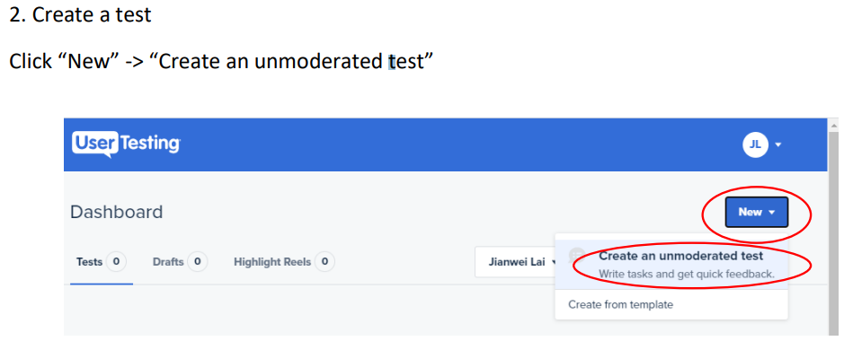

Slide 7
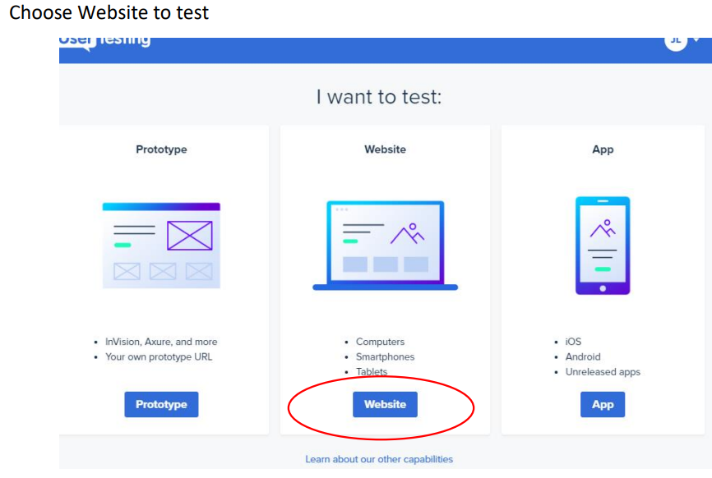

Slide 8
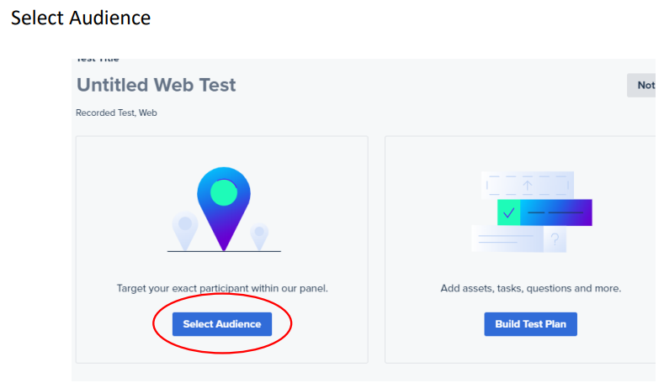
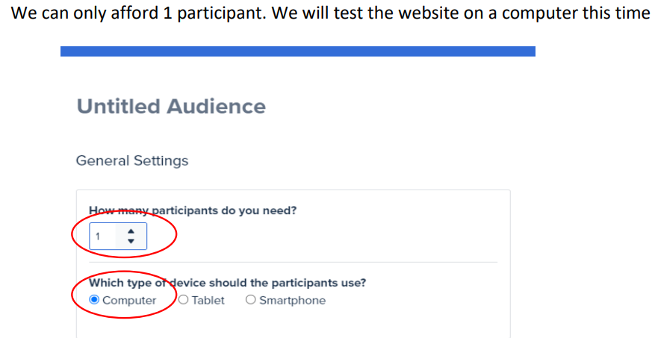

Slide 9
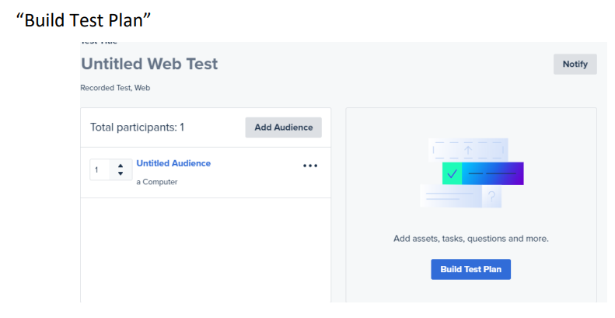

Slide 10
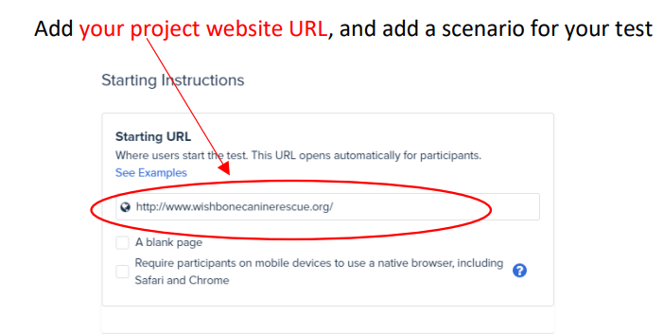

Slide 11
Sample Tasks

Slide 12
Starting Instructions (create your own for your project)
URL: http://lan.illinoisstate.edu/ (your project website)
Introduction: Assume you are a student who has taken a couple of years of college courses and are thinking about pursuing a Bachelor's and maybe later a Master's Degree in Spanish. You are looking at this department website to help you decide if this school/program might work for your needs.

Slide 13
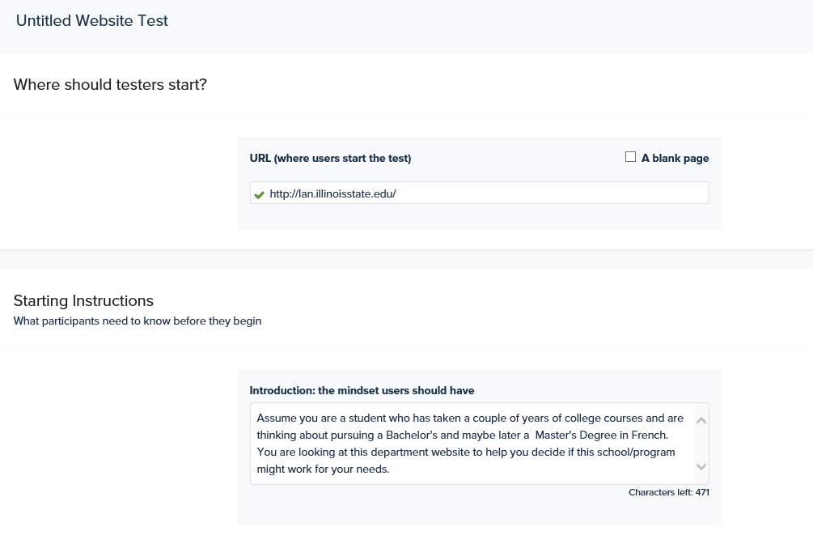

Slide 14
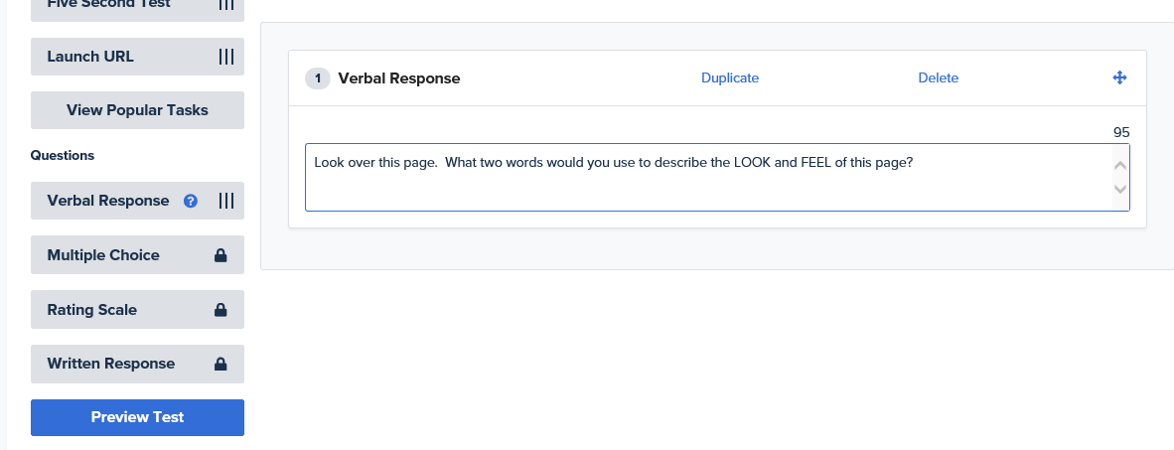
Verbal Response
Look over this page. What two words would you use to describe the LOOK and FEEL of this page? (Make your own question)

Slide 15
Verbal Response
(Don’t click on anything yet but feel free to scroll around.) What type of tasks do you think you could do on this page?

Slide 16
Verbal Response
What are your general thoughts about the list of choices in the navigation across the top of the page?

Slide 17
Verbal Response
(Don’t click on anything yet but just tell us what you expect to find.) What do you expect to find if you click on “Academics”?

Slide 18
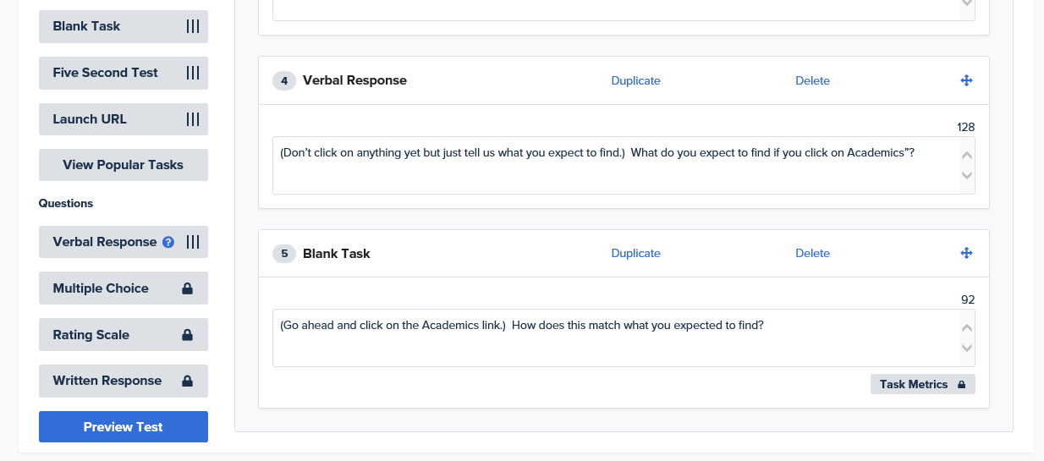
Blank Task
(Go ahead and click on the Academics link.) How does this match what you expected to find?

Slide 19
Verbal Response
(Don’t click on anything yet but just tell us what you expect to find.) What do you expect to find if you click on Graduate Program?

Slide 20
Task
(Go ahead and click on the Graduate Program Tab.) How does this match what you expected to find?

Slide 21
Task
(Go ahead and click on the Graduate Program link.) Would you expect to find information on the Spanish graduate program on the graduate pages or just under Spanish?

Slide 22
Verbal Response
(Don’t click on anything yet but just tell us what you expect to find.) What do you expect to find if you click on Study Abroad?

Slide 23
Task
(Go ahead and click on the Study Abroad link.) Was this what you expected to find?

Slide 24
Verbal Response
What could make this page better?

Slide 25
Task
Where would you go to get tutoring to work on your language skills?

Slide 26
Task
Where would you go to find information on getting experience with a language to help you get a better job in the future?

Slide 27
Task
What is the email address for Dr. Laura Edwards

Slide 28
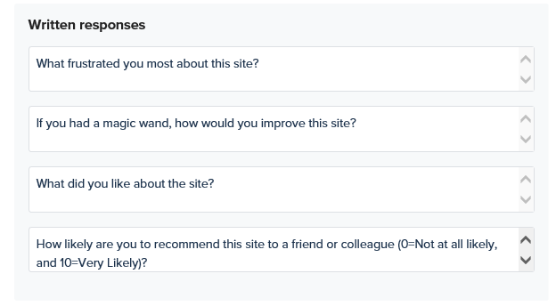
Add Post-Test Questionnaire
The questionnaire you want to add

Slide 29
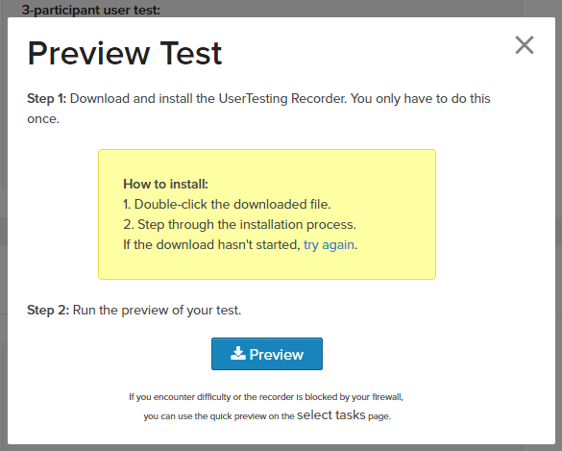

Slide 30
Note:
Only 1 participant (we can only afford 1!)
Preview your study before you launch it!
Do not pay for anything!

Slide 31
Assignment: Online test report for baseline site (10/26)
Create 12 questions. Make sure they are clear. Make sure you asked what you want to ask. Real people will do your test!!! Questionnaire is considered as 1 question.
Pre-review before you launch your test. Do not pay with real money!
Analyze your videos
Write a report to summarize your findings
Submit the report on Reggienet by 10/26

Slide 32
What to include in your report (Language website example)
Qualitative
Quantitative
Look and feel
Type of Tasks
Navigation
Expectations vs findings Undergraduate, Spanish, and Study Abroad
Where they found Tutoring if at all (path they took)
Where they found Job Experience (path they took)
Information under Spanish versus under the Graduate program
Study Abroad
Path they took to find email for Dr. Laura Edwards
Time to find grammar help desk
Success rate to find grammar help desk
Time to find job experience under http://lan.illinoisstate.edu/undergraduate/careers.shtml (or anything under Why Study)
Success rate to find job experience
Time to find email for Laura Edwards
Success rate to find email for Laura Edwards

Slide 33
Reminders
Exam 1 on 10/19
Peer evaluation due 10/19

